Slide 1
Introduction to Big Data with Apache Spark

Slide 2
Big data computing history review
http://research.google.com/archive/mapreduce.html

Slide 3
How is Spark different from Hadoop MapReduce

Slide 4
Hadoop Map-reduce

Slide 5



Hadoop Map-reduce

Slide 6
Apache Spark
Keep more data in-memory!
Create new distributed execution engine:
http://people.csail.mit.edu/matei/papers/2010/hotcloud_spark.pdf

Slide 7









Spark tools

Slide 8
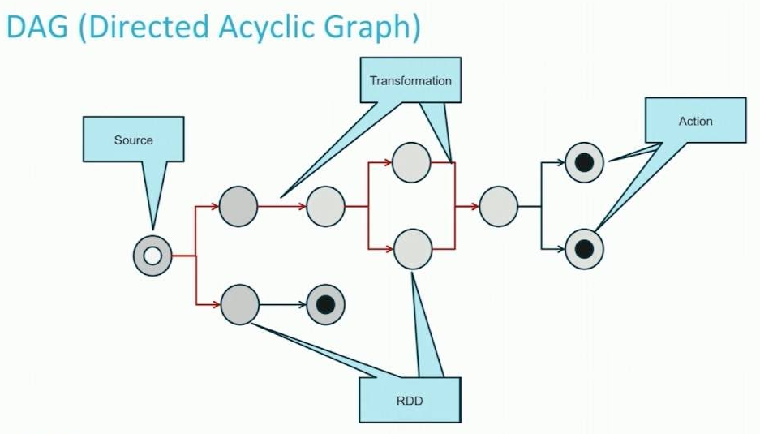
Spark vs. Hadoop map reduce
 | Hadoop MapReduce | Spark
Storage | Often on hard disc | Mainly in memory and on hard disc
Operations | Map and reduce | Transformation and action
Execution model | Batch | Batch, streaming, interactive, iterative
Programming environments | Java | Scala, Java, Python, R

Slide 9


In-memory can make a big difference

Slide 10















How Spark runs on clusters

Slide 11
How to write a Spark program

Slide 12
SparkContext
A Spark program first creates a SparkContext object
represents the connection to a Spark execution environment
Use SparkContext to create RDDs

Slide 13









Resilient Distributed Datasets (RDDs)
The primary data structure in Spark
- Formally, an RDD is a read-only, partitioned collection of records
- RDDs often do not need to be materialized.
- Immutable once constructed
RDDs built and manipulated through a diverse set of parallel transformations (map, filter, join) and actions ( count, collect, save)
You construct RDDs
- by parallelizing existing Python collections (lists)
- by transforming an existing RDD
- from files in HDFS or any other storage system

Slide 14

Working with RDDs
Create an RDD from a data source: file, list
Apply transformations to an RDD: map, filter
Apply actions to an RDD: collect, count
http://spark.apache.org/docs/latest/programming-guide.html

Slide 15
Create RDD from list
>>> data = [1, 2, 3, 4, 5]
>>> data [1, 2, 3, 4, 5]
>>> rDD = sc.parallelize(data, 4)
>>> rDD

Slide 16
Create RDD from file
distFile = sc.textFile("...", 4)

Slide 17
Spark also include two major types of processes
Transformation
Action

Slide 18
Transformations
Create new RDDS from an existing one
Notes:
Rdd.filter(removeEven) [1,2,2,3]->[1,3]

Slide 19







Transformation
rdd = sc.parallelize([1, 2, 3, 4])
>>> rdd.map(lambda x: x * 2)
RDD: [1, 2, 3, 4] → [2, 4, 6, 8]
>>> rdd.filter(lambda x: x % 2 == 0)
RDD: [1, 2, 3, 4] → [2, 4]
>>> rdd2 = sc.parallelize([1, 4, 2, 2, 3]) >>> rdd2.distinct()
RDD: [1, 4, 2, 2, 3] → [1, 4, 2, 3]
When we transform a RDD, Spark does Lazy evaluation, which means nothing executes – Spark saves recipe for transforming source

Slide 20


Transformation
>>> rdd = sc.parallelize([1, 2, 3])
>>> rdd.map(lambda x: [x, x+5])
RDD: [1, 2, 3] → [[1, 6], [2, 7], [3, 8]]
>>> rdd.flatMap(lambda x: [x, x+5])
RDD: [1, 2, 3] → [1, 6, 2, 7, 3, 8]

Slide 21
Spark Actions
Cause Spark to execute recipe to transform source
Mechanism for getting results out of Spark

Slide 22
Actions
>>> rdd = sc.parallelize([1, 2, 3])
>>> rdd.reduce(lambda a, b: a * b)
Value: 6
>>> rdd.take(2) Value: [1,2] # as list
>>> rdd.collect() Value: [1,2,3] # as list
>>>rdd = sc.parallelize([5,3,1,2])
>>> rdd.takeOrdered(3, lambda s: -1*s)
Value: [5,3,2] # as list

Slide 23
Spark Programming Model
lines = sc.textFile("...", 4)
print lines.count()
count() causes Spark to:
• read data
• sum within partitions
• combine sums in driver

Slide 24
Spark Programming Model
lines = sc.textFile("...", 4)
comments = lines.filter(isComment)
print(lines.count(), comments.count())
Spark recomputes lines:
• read data (again)
• sum within partitions
• combine sums in driver

Slide 25



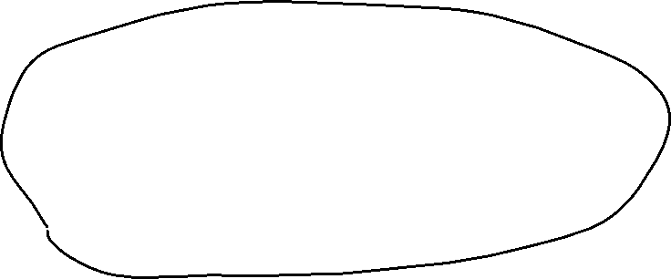





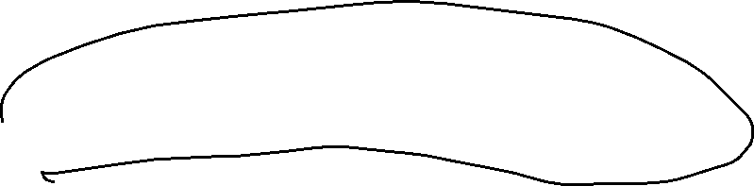


















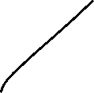
Cache RDDs
lines = sc.textFile("...", 4)
lines.cache() # save, don't recompute!
comments = lines.filter(isComment)
Print( lines.count(),comments.count() )

Slide 26
Spark Program Lifecycle
Create RDDs from external data or parallelize a collection in your driver program
Lazily transform them into new RDDs
cache() some RDDs for reuse
Perform actions to execute parallel computation and produce results

Slide 27
Map-reduce in Spark

Slide 28
Spark Key-Value RDDs
Similar to Map Reduce, Spark supports Key-Value pairs
Each element of a Pair RDD is a pair tuple
>>> rdd = sc.parallelize([(1, 2), (3, 4)])
RDD: [(1, 2), (3, 4)]

Slide 29
Some Key-Value Transformations

Slide 30


Some Key-Value Transformations
>>> rdd = sc.parallelize([(1,2), (3,4), (3,6)])
>>> rdd.reduceByKey(lambda a, b: a + b)
RDD: [(1,2), (3,4), (3,6)] → [(1,2), (3,10)]
>>> rdd2 = sc.parallelize([(1,'a'), (2,'c'), (1,'b')])
>>> rdd2.sortByKey()
RDD: [(1,'a'), (2,'c'), (1,'b')] → [(1,'a'), (1,'b'), (2,'c')]

Slide 31
Key-Value Transformations
>>> rdd2 = sc.parallelize([(1,'a'), (2,'c'), (1,'b')])
>>> rdd2.groupByKey()
RDD: [(1,'a'), (1,'b'), (2,'c')] → [(1,['a','b']), (2,['c'])]
Be careful using groupByKey() as it can cause a lot of data movement across the network and create large Iterables

